Slide 1


Deep Fake Identification
An AI-powered Platform Designed to Differentiate Between Real and Fake Contents.
Presented By
Swarnadri Sekhar Mukherjee Deb kumar Mondal Soumyadeep Shaw
Meet Kasediya Tanya Kumari Sunny Kumar Prabhjot Kaur Arya Gupta
Under Guidance of
Mr. Harjaspreet Singh
To
SABUDH FOUNDATION
Date of Reporting: Nov 03rd 2025

Slide 2

Problem Statement :-
With the rapid advancement of AI, DeepFake Technology has made it possible to create highly realistic fake images that are extremely difficult for humans to identify as fake. These deepfakes can be misused for unethical purposes, including:
Spreading misinformation and fake news
Creating fraudulent or malicious content
Damaging reputations and privacy
Hence, there is a need for an automated, AI-based detection system capable of distinguishing real images from deepfakes with high accuracy and reliability.
Our goal is to design and develop a ANN–based model that can analyze image features and classify them as real or fake, contributing to a safer and more trustworthy digital environment.
02

Slide 3

Datasets & Tools :-
Kaggle:- Datasets were used from Kaggle
StyleGan-StyleGan2 Deepfake Face Images:- https://www.kaggle.com/datasets/kshitizbhargava/deepfake-face-images
Real vs fake faces :- https://www.kaggle.com/datasets/uditsharma72/real-vs-fake-faces
Deepfake and real images:- https://www.kaggle.com/datasets/manjilkarki/deepfake-and-real-images?
Final Combined Dataset:-
Real Images:- 65558
Fake Images:- 77954
Libraries Used:-
OpenCV :- An open-source computer vision library used for image processing and object detection, enabling efficient extraction and manipulation of visual features.
MTCNN :- A deep learning-based framework designed for accurate face detection and alignment in images.
PyTorch :- A framework for implementing and optimizing neural network models efficiently. Used for building, training, and evaluating deep learning models.
03

Slide 4
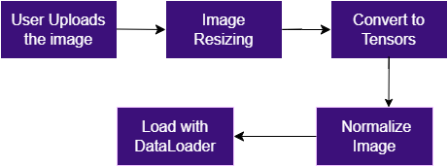
Image Preprocessing Steps :-
Dataset Integration:-
Combined three Kaggle datasets containing real and deepfake face images.
Data Cleaning:-
Verified all images to remove corrupted files using PIL.
Removed duplicate images based on MD5 hash comparison.
Image Organization:-
Separated images into ‘real’ and ‘fake’ folders for consistency.
Image Augmentation & Normalization:- Applied transformations using PyTorch’s transforms:
Resized all images to 224×224 pixels
Random horizontal flip and rotation for variation
Adjusted brightness and contrast with ColorJitter
Converted images to tensors and normalized (mean = 0.5, std = 0.5)
Final Dataset Creation:-
All preprocessed images were merged into a single combined dataset and zipped for model training.
Workflow
04

Slide 5

Work Progress :-
Data Collection & Preprocessing:
Custom Dataset Created through collection of images from various deepfake datasets.
Dataset is cleaned and preprocessed.
Cropping based on facial features:
Implemented OpenCV and MTCNN to crop and extract only facial regions from images for cleaner inputs.
The cropped facial images will be fed to our classifier architecture as inputs.
05

Slide 6
Work Progress :-
ResNet Embedding Phase and Baseline : Used ResNet-50 pretrained on ImageNet to extract feature embeddings. Saved embeddings in .npy format and used them as input for a custom neural classifier. Achieved around 80% test accuracy using these learned embeddings. Identified limitations in ResNet’s ability to capture global dependencies and fine texture differences in fake faces.
Trial with VIT : Integrated Hugging Face ViT (vit-base-patch 16-224) model pre trained on ImageNet-21K. Unfroze and fine-tuned the last two transformer layers for deepfake classification. Extracted [CLS] token embeddings representing global image features internally. Achieved ~97% test accuracy, showing major improvement over the ResNet baseline. Saved the trained model as .pth files (weights + optimizer state).
06

Slide 7
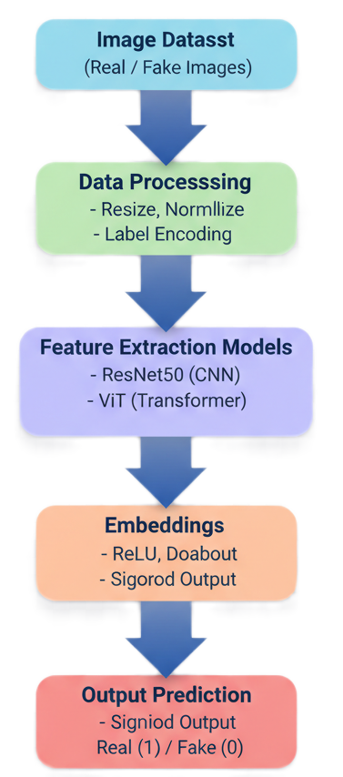
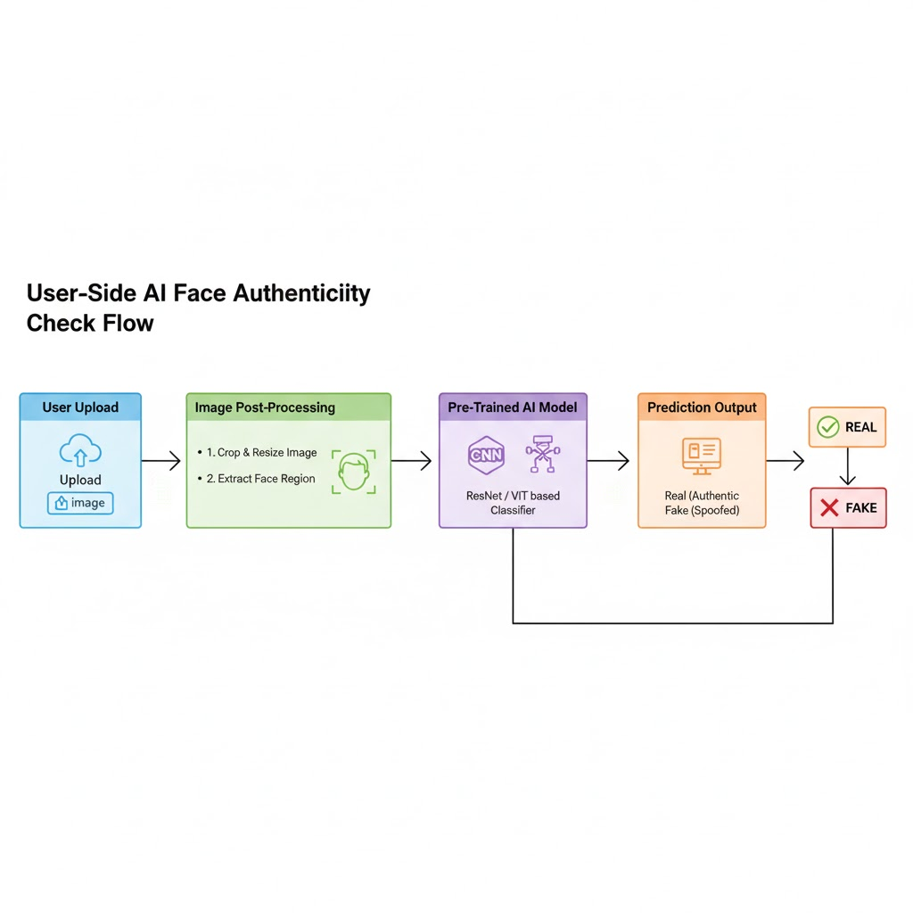
Methodology :-
Data Collection & Cleaning Imported real and fake face images and preprocessed them for uniformity.
Feature Extraction Generated image embeddings using ResNet50 and ViT pretrained models.
Model Training Fed embeddings into an Artificial Neural Network (ANN) for binary classification.
Evaluation Compared model accuracy, loss, and performance on test data.
Visualization & Analysis Analyzed confusion matrix and accuracy curves to understand model behavior.
07

Slide 8

Next Steps :-
Enhancing Model Performance and Architecture :
Experiment with other Vision Transformers (ViT variants) and fine-tuning strategies.
Explainability & Visualization :
Visualize attention maps from ViT to see which parts of the face the model focuses on.
Analyze misclassified samples to understand and fix model weaknesses.
Model Deployment :
Convert and deploy the model as a Flask / FastAPI web app for easy testing
Implement a simple frontend where users upload a photo to check if it’s real or fake.
Save and load the model in production-ready format for direct reuse.
08

Slide 9
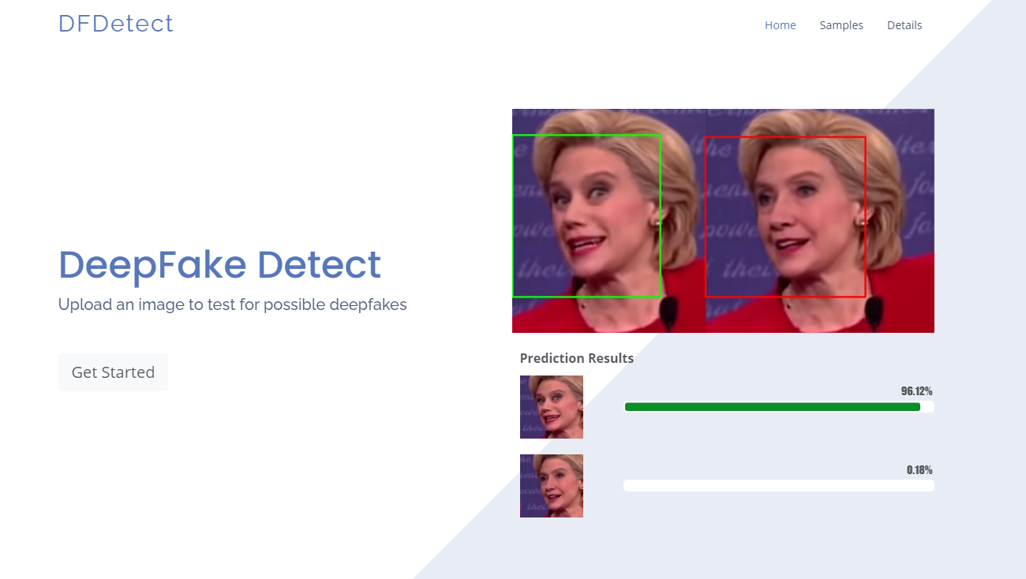
Future Extensions :-
Expand from static image detection to Multitype Deepfake detection.
Optional deployment integrated with whatsapp and other social media.
Combine ViT with other features for better accuracy on low-quality or compressed images.
09

Slide 10

Thank You

